Slide 1

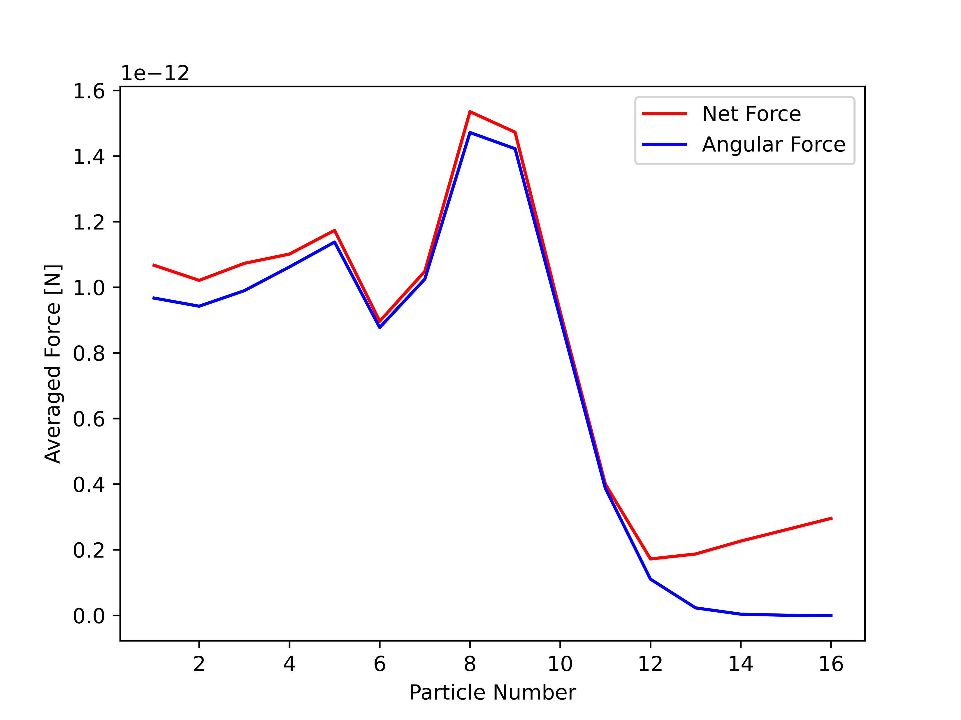
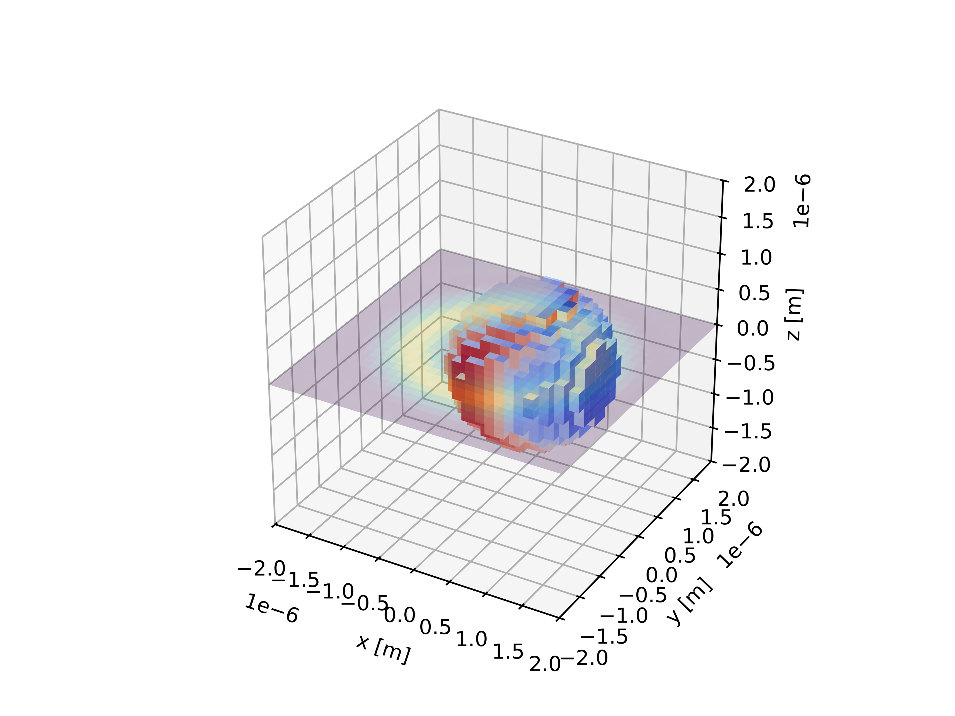
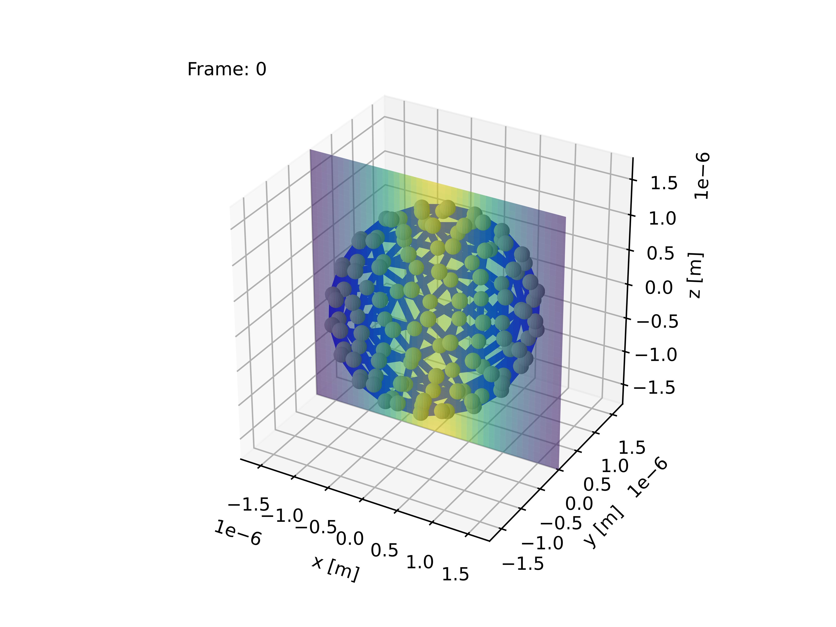
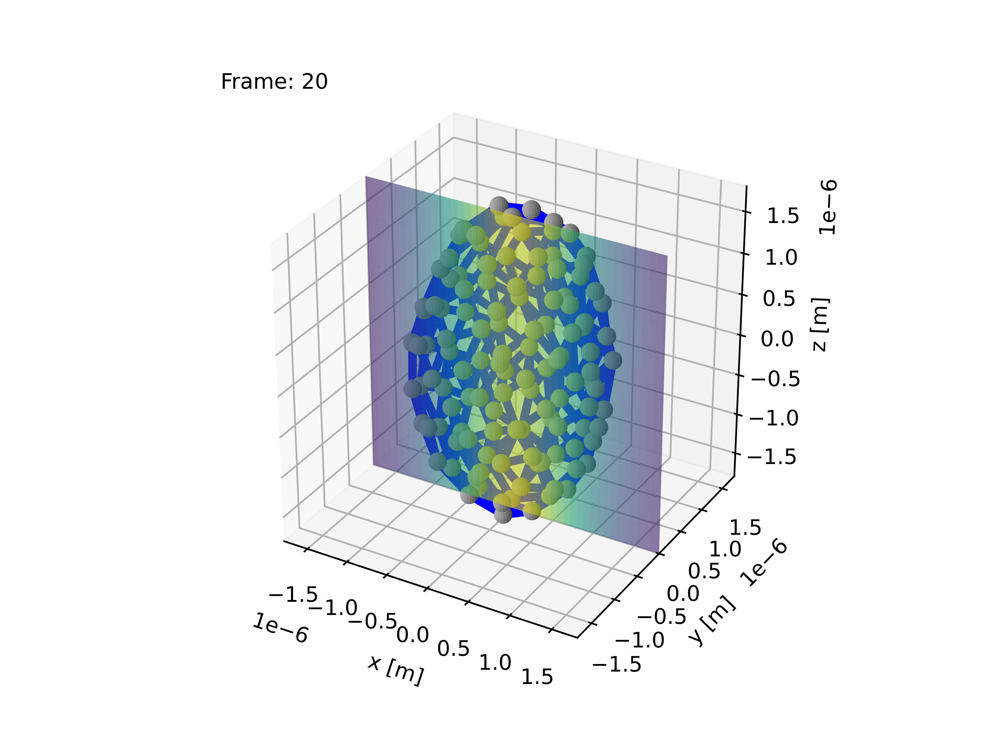
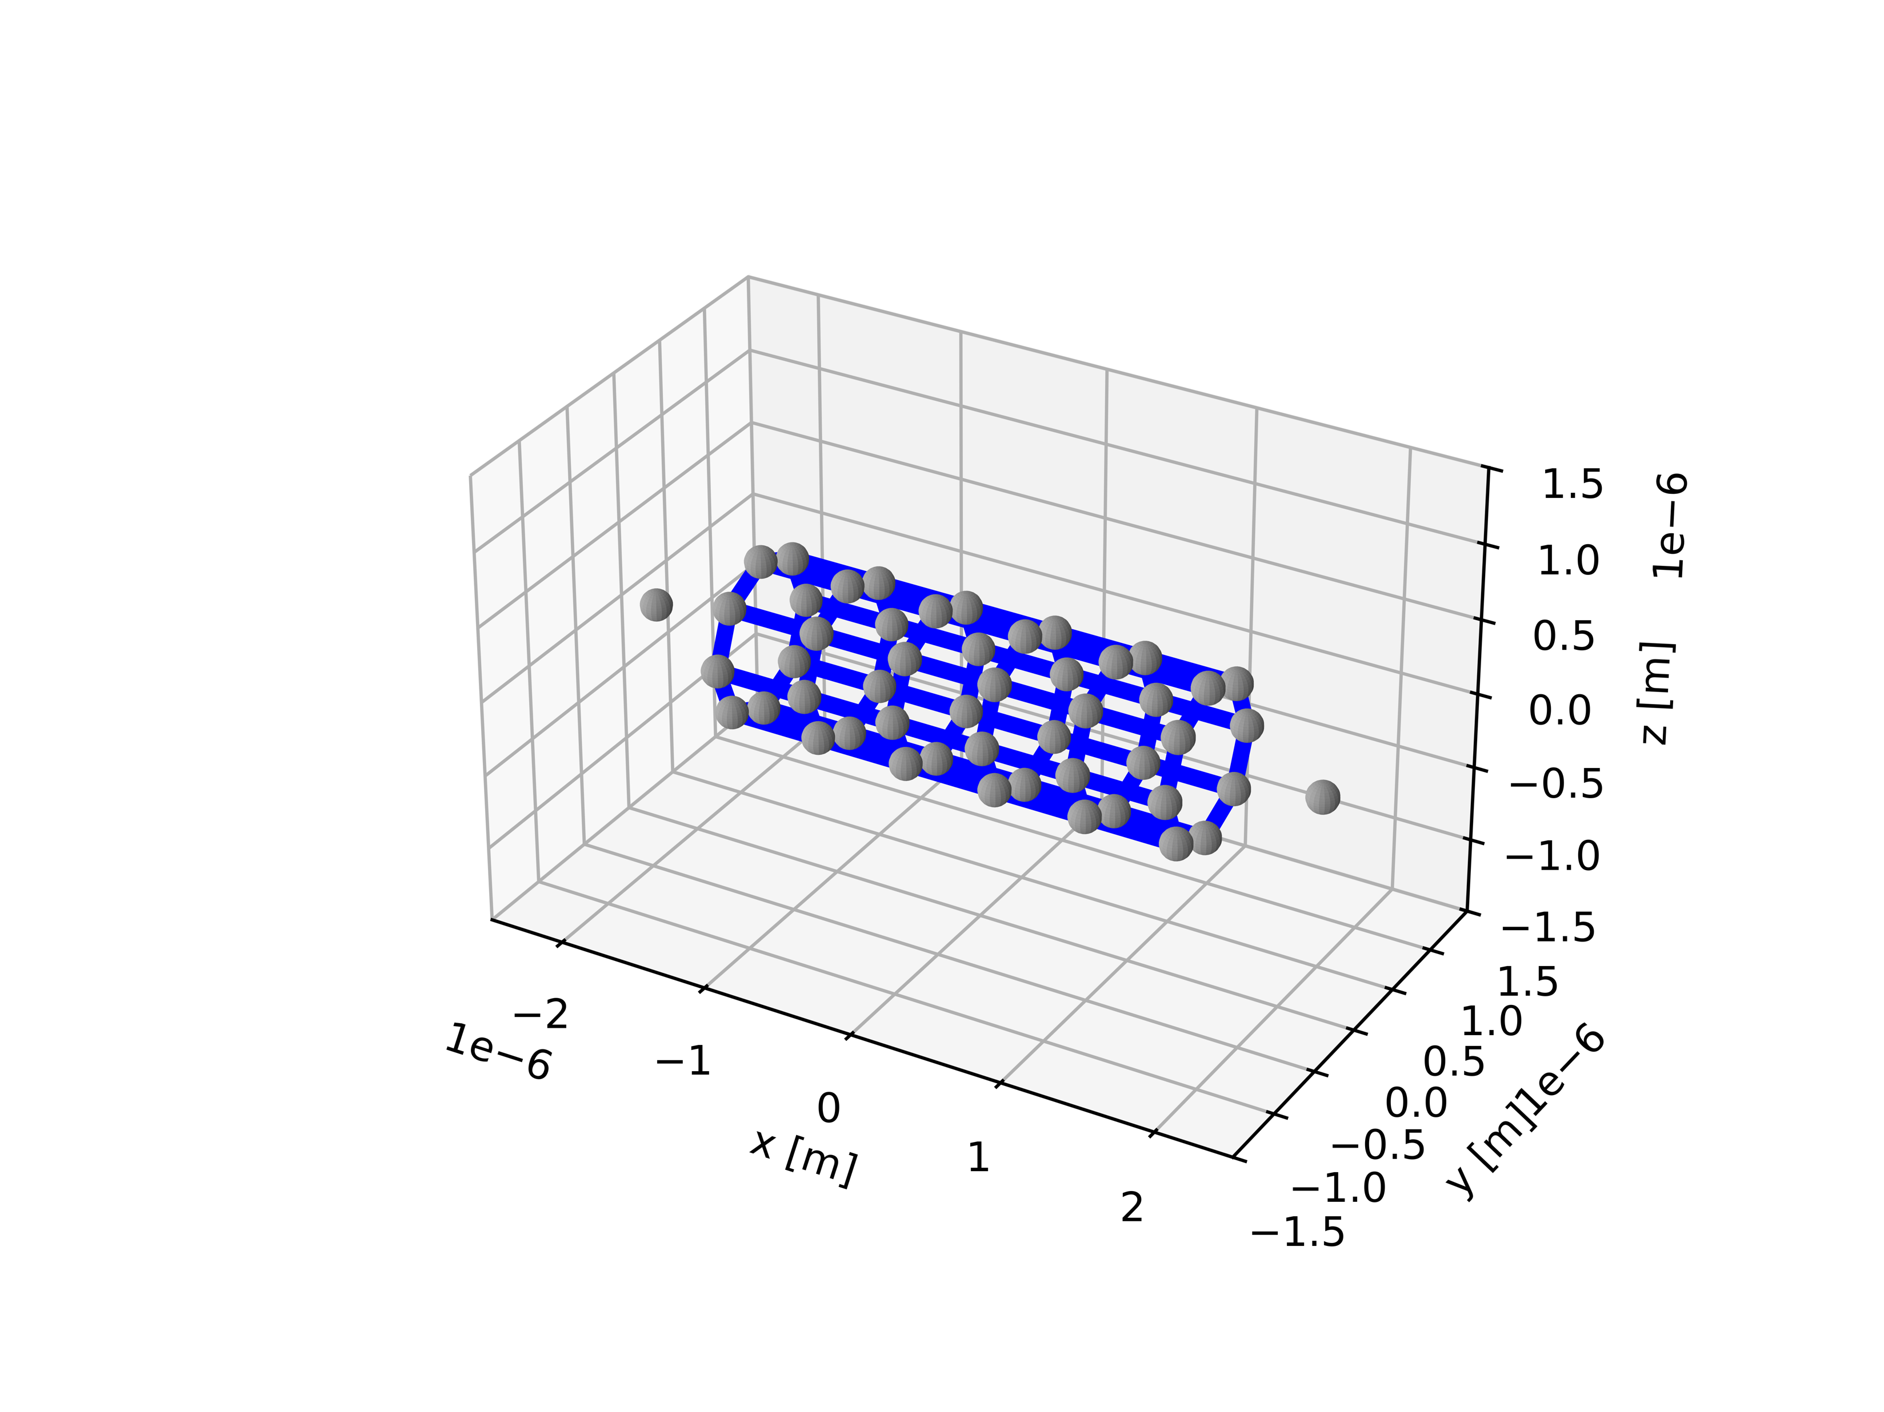
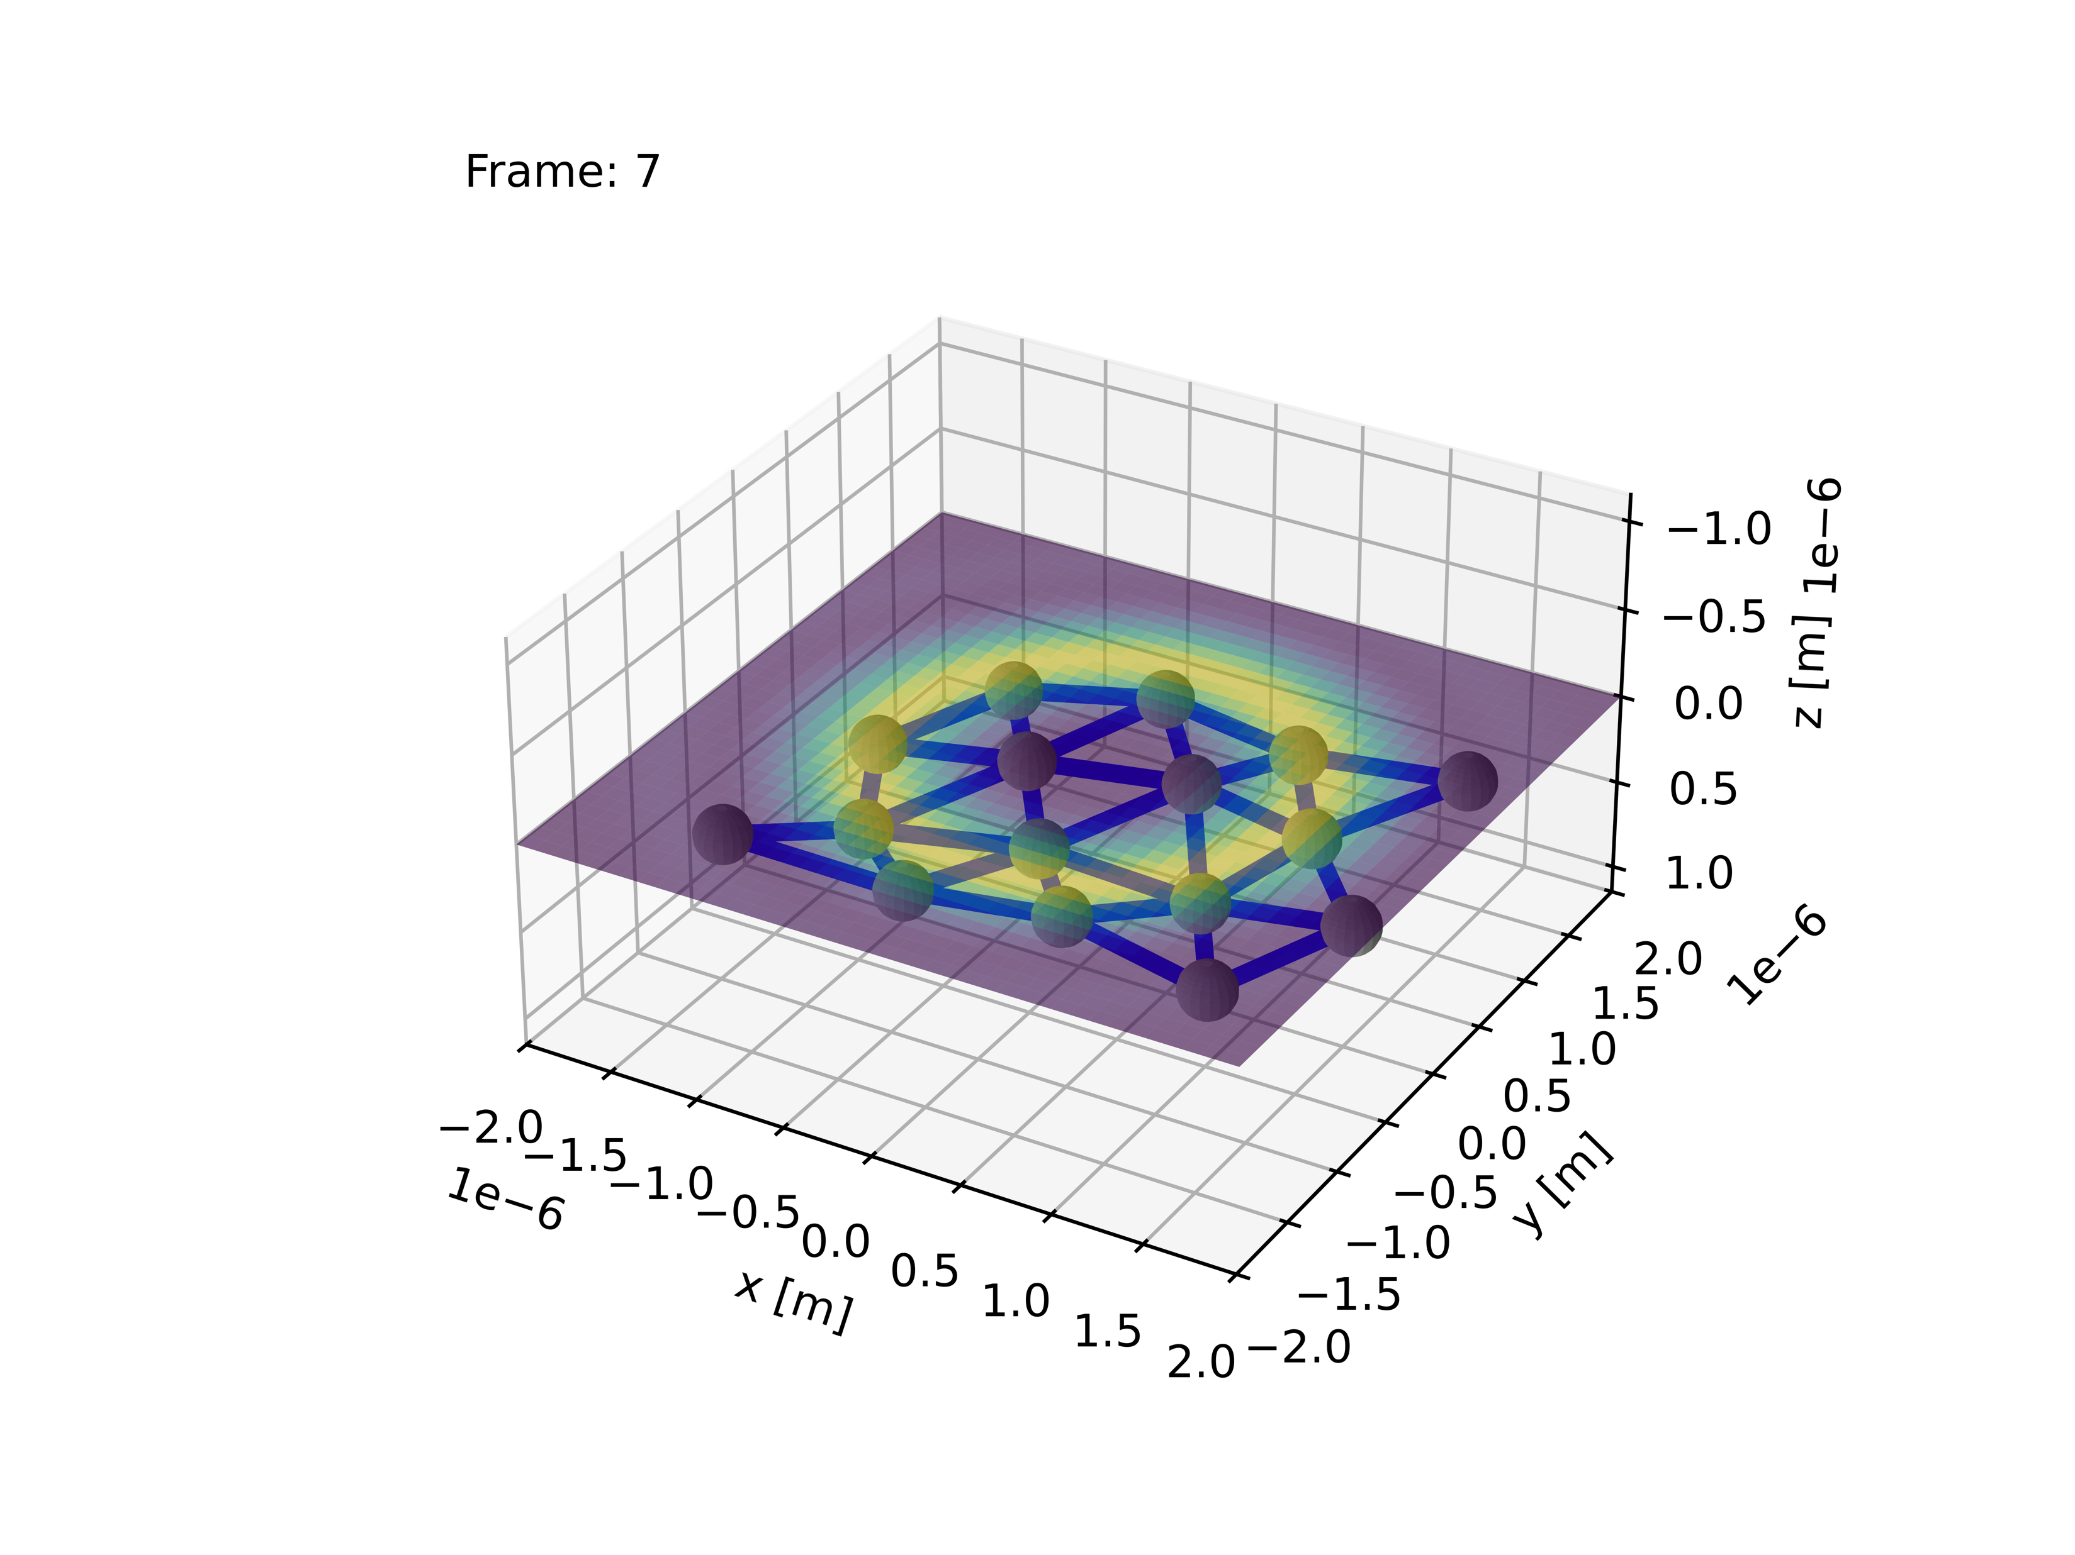
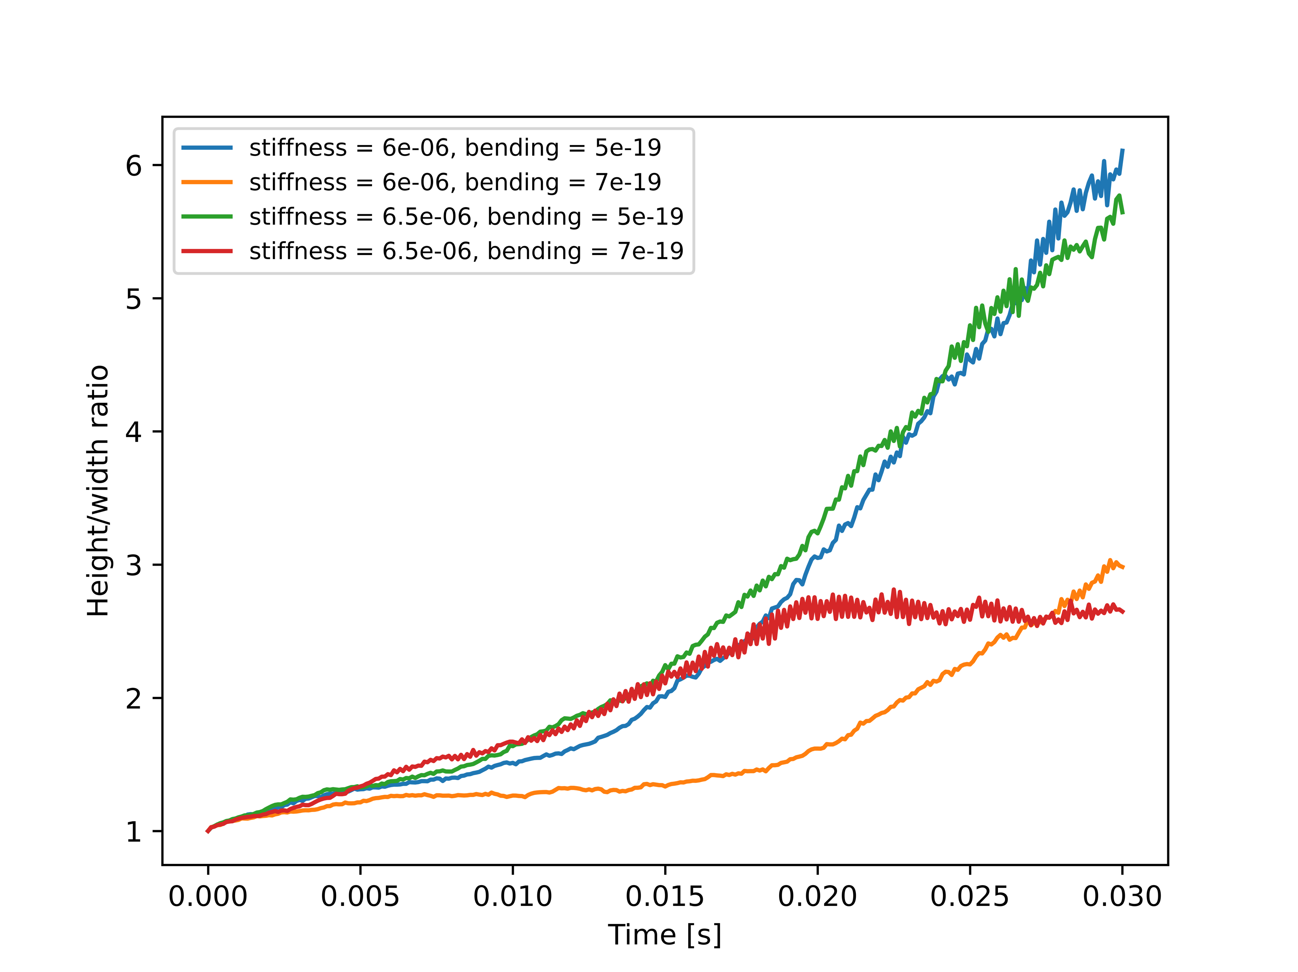
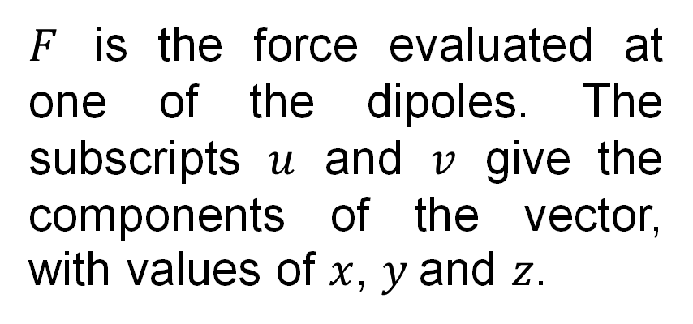
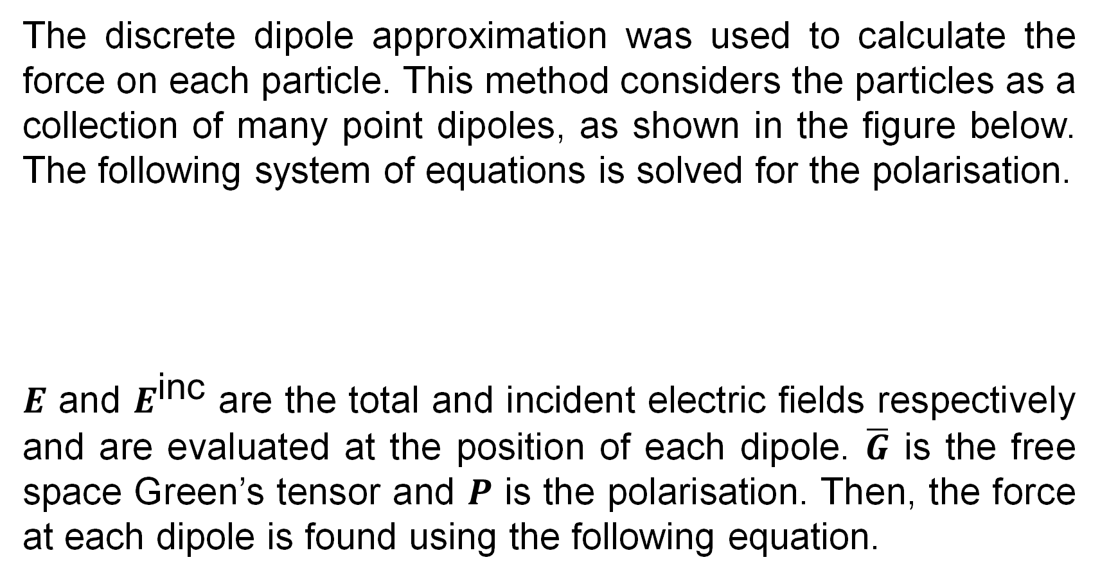
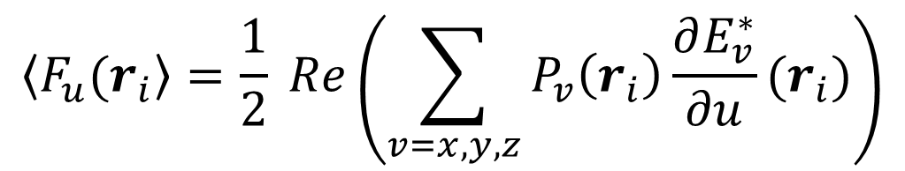
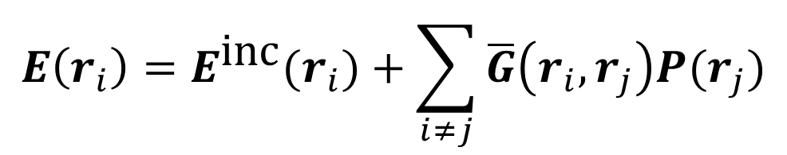
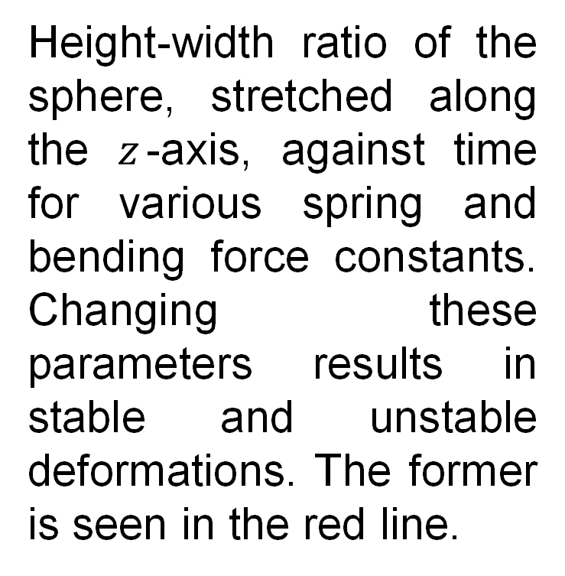
Applying a bead and spring framework to light-driven deformation
David Tudor and James Paget (Supervisor : Professor S. Hanna)
March: 2025
Introduction
School of Physics
Results – model validation
The optical forces from a laser beam can manipulate microscopic particles. These are used as optical tweezers to control flexible biological cells and have medical applications which could be researched more efficiently through the simulation of optically dense, deformable objects.
The force on a set of rigid particles can be calculated using existing methods such as the discrete dipole approximation (DDA). However, the Abraham-Minkowski controversy only guarantees the accuracy of the total force on the object, not the force densities. This experiment simulated the forces as a flexible object was divided into rigid particles to validate the adjust
bead and spring model. Then, the simulation’s predictions were compared to experimental results.
Total and angular force on each spherical particle as more are added in a ring formation near the high intensity annulus of a Laguerre-Gaussian beam.
Cube object approximated by spherical or cubic particles. The model is refined by using more particles and dipoles.
Total force exerted on the cube object as the dipole size is refined for various particles sizes and shapes.
The visualised stresses for a sphere in a Laguerre-Gaussian beam modelled using the DDA method.
Results – optical stretcher
Results – general dynamics
Flexible rod modelled by a hollow tube, connected to two outer silica beads with unique spring constants. Blue links represent particles connected by a spring and bending force.
Experimental Methods
The discrete dipole approximation was used to calculate the force on each particle. This method considers the particles as a collection of many point dipoles, as shown in the figure below. The following system of equations is solved for the polarisation.
$E$ and $E^{\text{inc}}$ are the total and incident electric fields respectively and are evaluated at the position of each dipole. $\overline{G}$ is the free space Green’s tensor and $P$ is the polarisation. Then, the force at each dipole is found using the following equation.
Silica beads connected to the ends of a flexible, hollow rod. Translating two Gaussian beams, each trapping a bead, causes the rod to deflect in a dynamics simulation.
$$E\left(r_{i}\right)=E^{\text{inc}}(r_{i})+\sum_{i≠j}{\overline{G}\left(r_{i}, r_{j}\right)P(r_{j})}$$
Spherical shell stretched by two counter-propagating Gaussian beams in a dynamics simulation. Compared to Guck et al Biophysical journal 81.2 (2001): 767-784.
$$\left\langle F_{u}(r_{i}\right\rangle =\frac{1}{2} Re\left(\sum_{v=x,y,z}{P_{v}\left(r_{i}\right)}\frac{∂E_{v}^{∗}}{∂u}(r_{i})\right)$$
Height-width ratio of the sphere, stretched along the $z$-axis, against time for various spring and bending force constants. Changing these parameters results in stable and unstable deformations. The former is seen in the red line.
$F$ is the force evaluated at one of the dipoles. The subscripts $u$ and $v$ give the components of the vector, with values of $x$, $y$ and $z$.
A single layer of particles in a 2D triangular lattice.
Conclusions
Verified that a bead-spring framework can accurately model a larger object through the sum of its constituent spherical particles in a DDA simulation of high refinement, despite Abraham-Minkowski concerns.
Considered several configurations of connected particles alongside a variety of structural coefficients, demonstrated qualitative deformation in connected systems and matched experimental stretching of a spherical shell.
In a low Reynolds number regime, the system's force can be equated to a zero inertial term. The net force is zero, which is the sum of the optical, spring, bending, drag and Buckingham components. The system is time stepped using the resulting differential equation.

